Slide 1
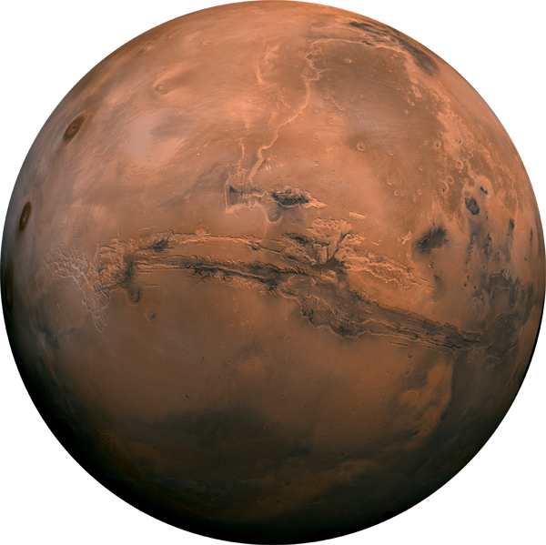
ANALYSIS OF INTER-CRATER BASIN STRATA ON MARS THROUGH LARGE-SCALE GEOLOGIC AND GEOMORPHIC MAPPING
By: Michelle Barton
Mentor: Jim Skinner

Slide 2
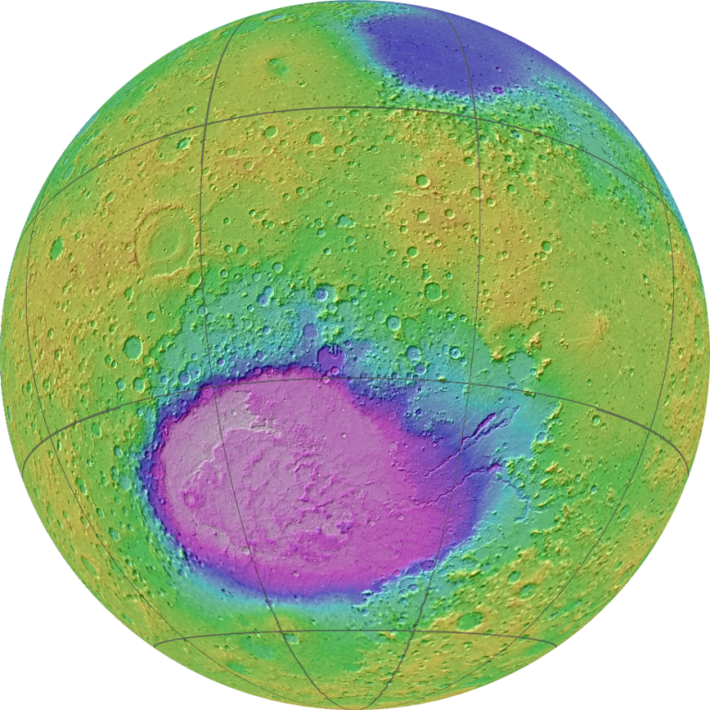
Hadriacus Cavi
Hadriacus Cavi are a series of irregularly-shaped depressions in the Martian cratered highlands.
Located east of Terby crater on the northeast rim of Hellas Basin.
Our study focuses on a 26 km long and 29 km wide region.
HADRIACUS PALUS
HELLAS PLANITIA
The cavi expose stratified (stacked) rock layers.
Predominantly alternating light- and dark-toned layers ~500 m thick.
The units are likely to have been emplaced through volcanic, fluvial, mass-wasting, aeolian, and impact processes.
10km

Slide 3
Project Importance
Inter-crater basin filling processes on Mars.
The Cavi expose geologic history of complex area.
Proposed as a Mars 2020 rover landing site.
Mapping scale of Hadriacus differs from other maps 1:24,000 vs 1:20,000,000 Mars global map.
0.5 km

Slide 4
Methods and Data
High Resolution Imaging Science Experiment (HiRISE).
The context camera (CTX).
The Mars Reconnaissance Orbiter (MRO) carries the CTX and HiRISE instruments.
ArcGIS Software and ArcScene (Geographical Information Systems).
Geomorphic Mapping vs Geologic/Unit Mapping.
Complications occurred while unit mapping, directing focus towards geomorphic features.
The above image is of channel-form features, stratified deposits, and large crustal uplifts, viewed in Arcscene.

Slide 5
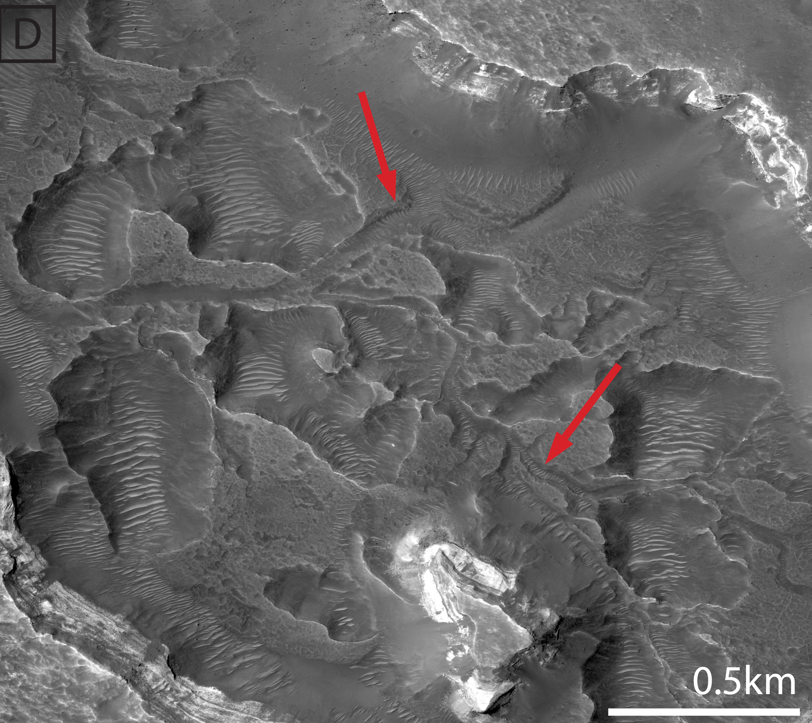
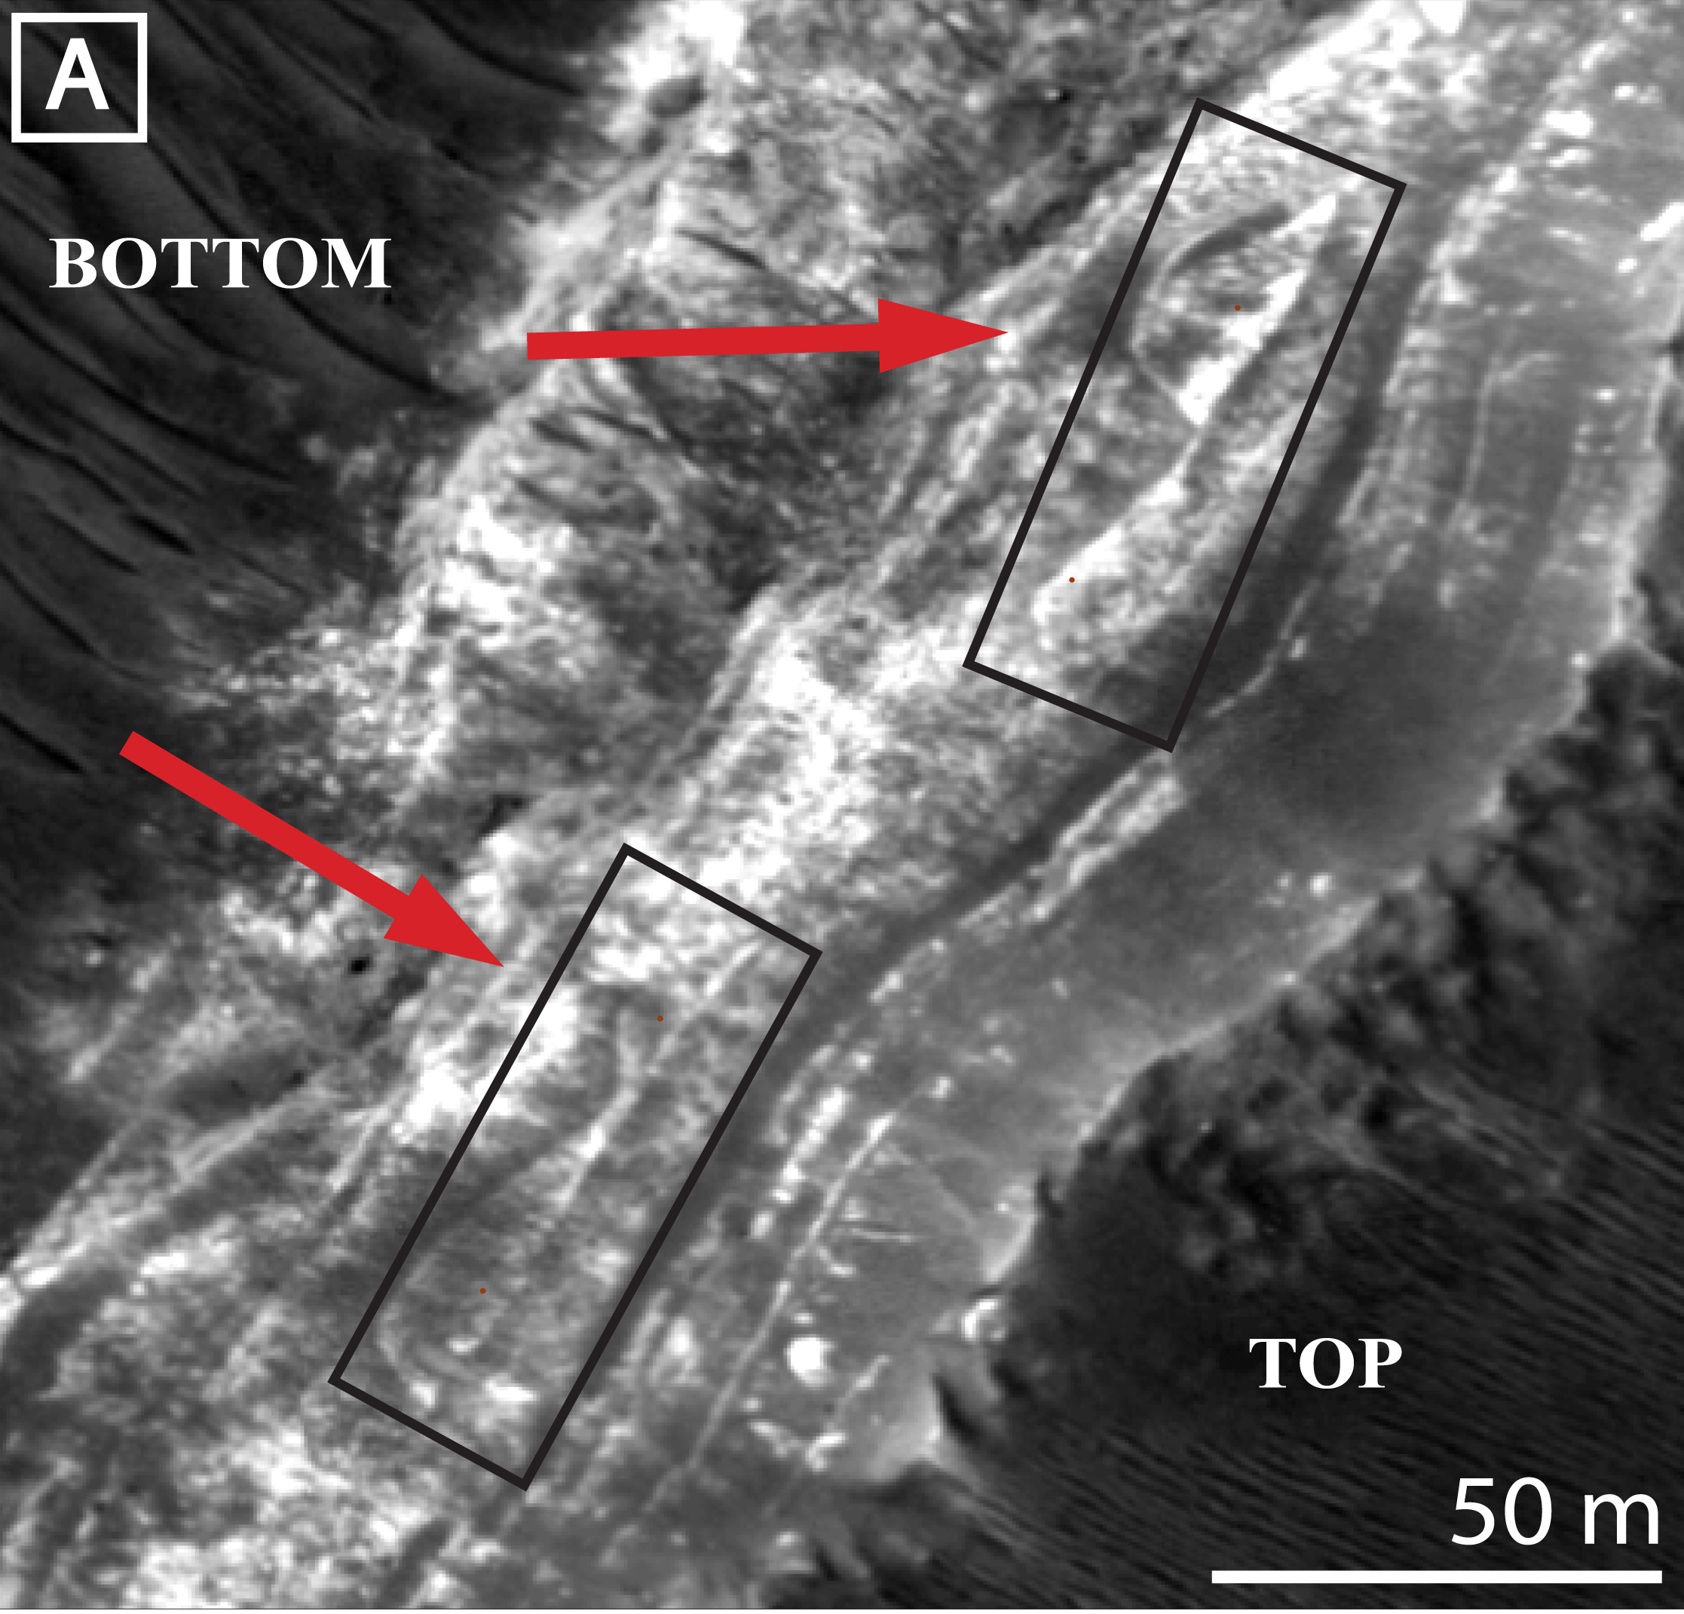
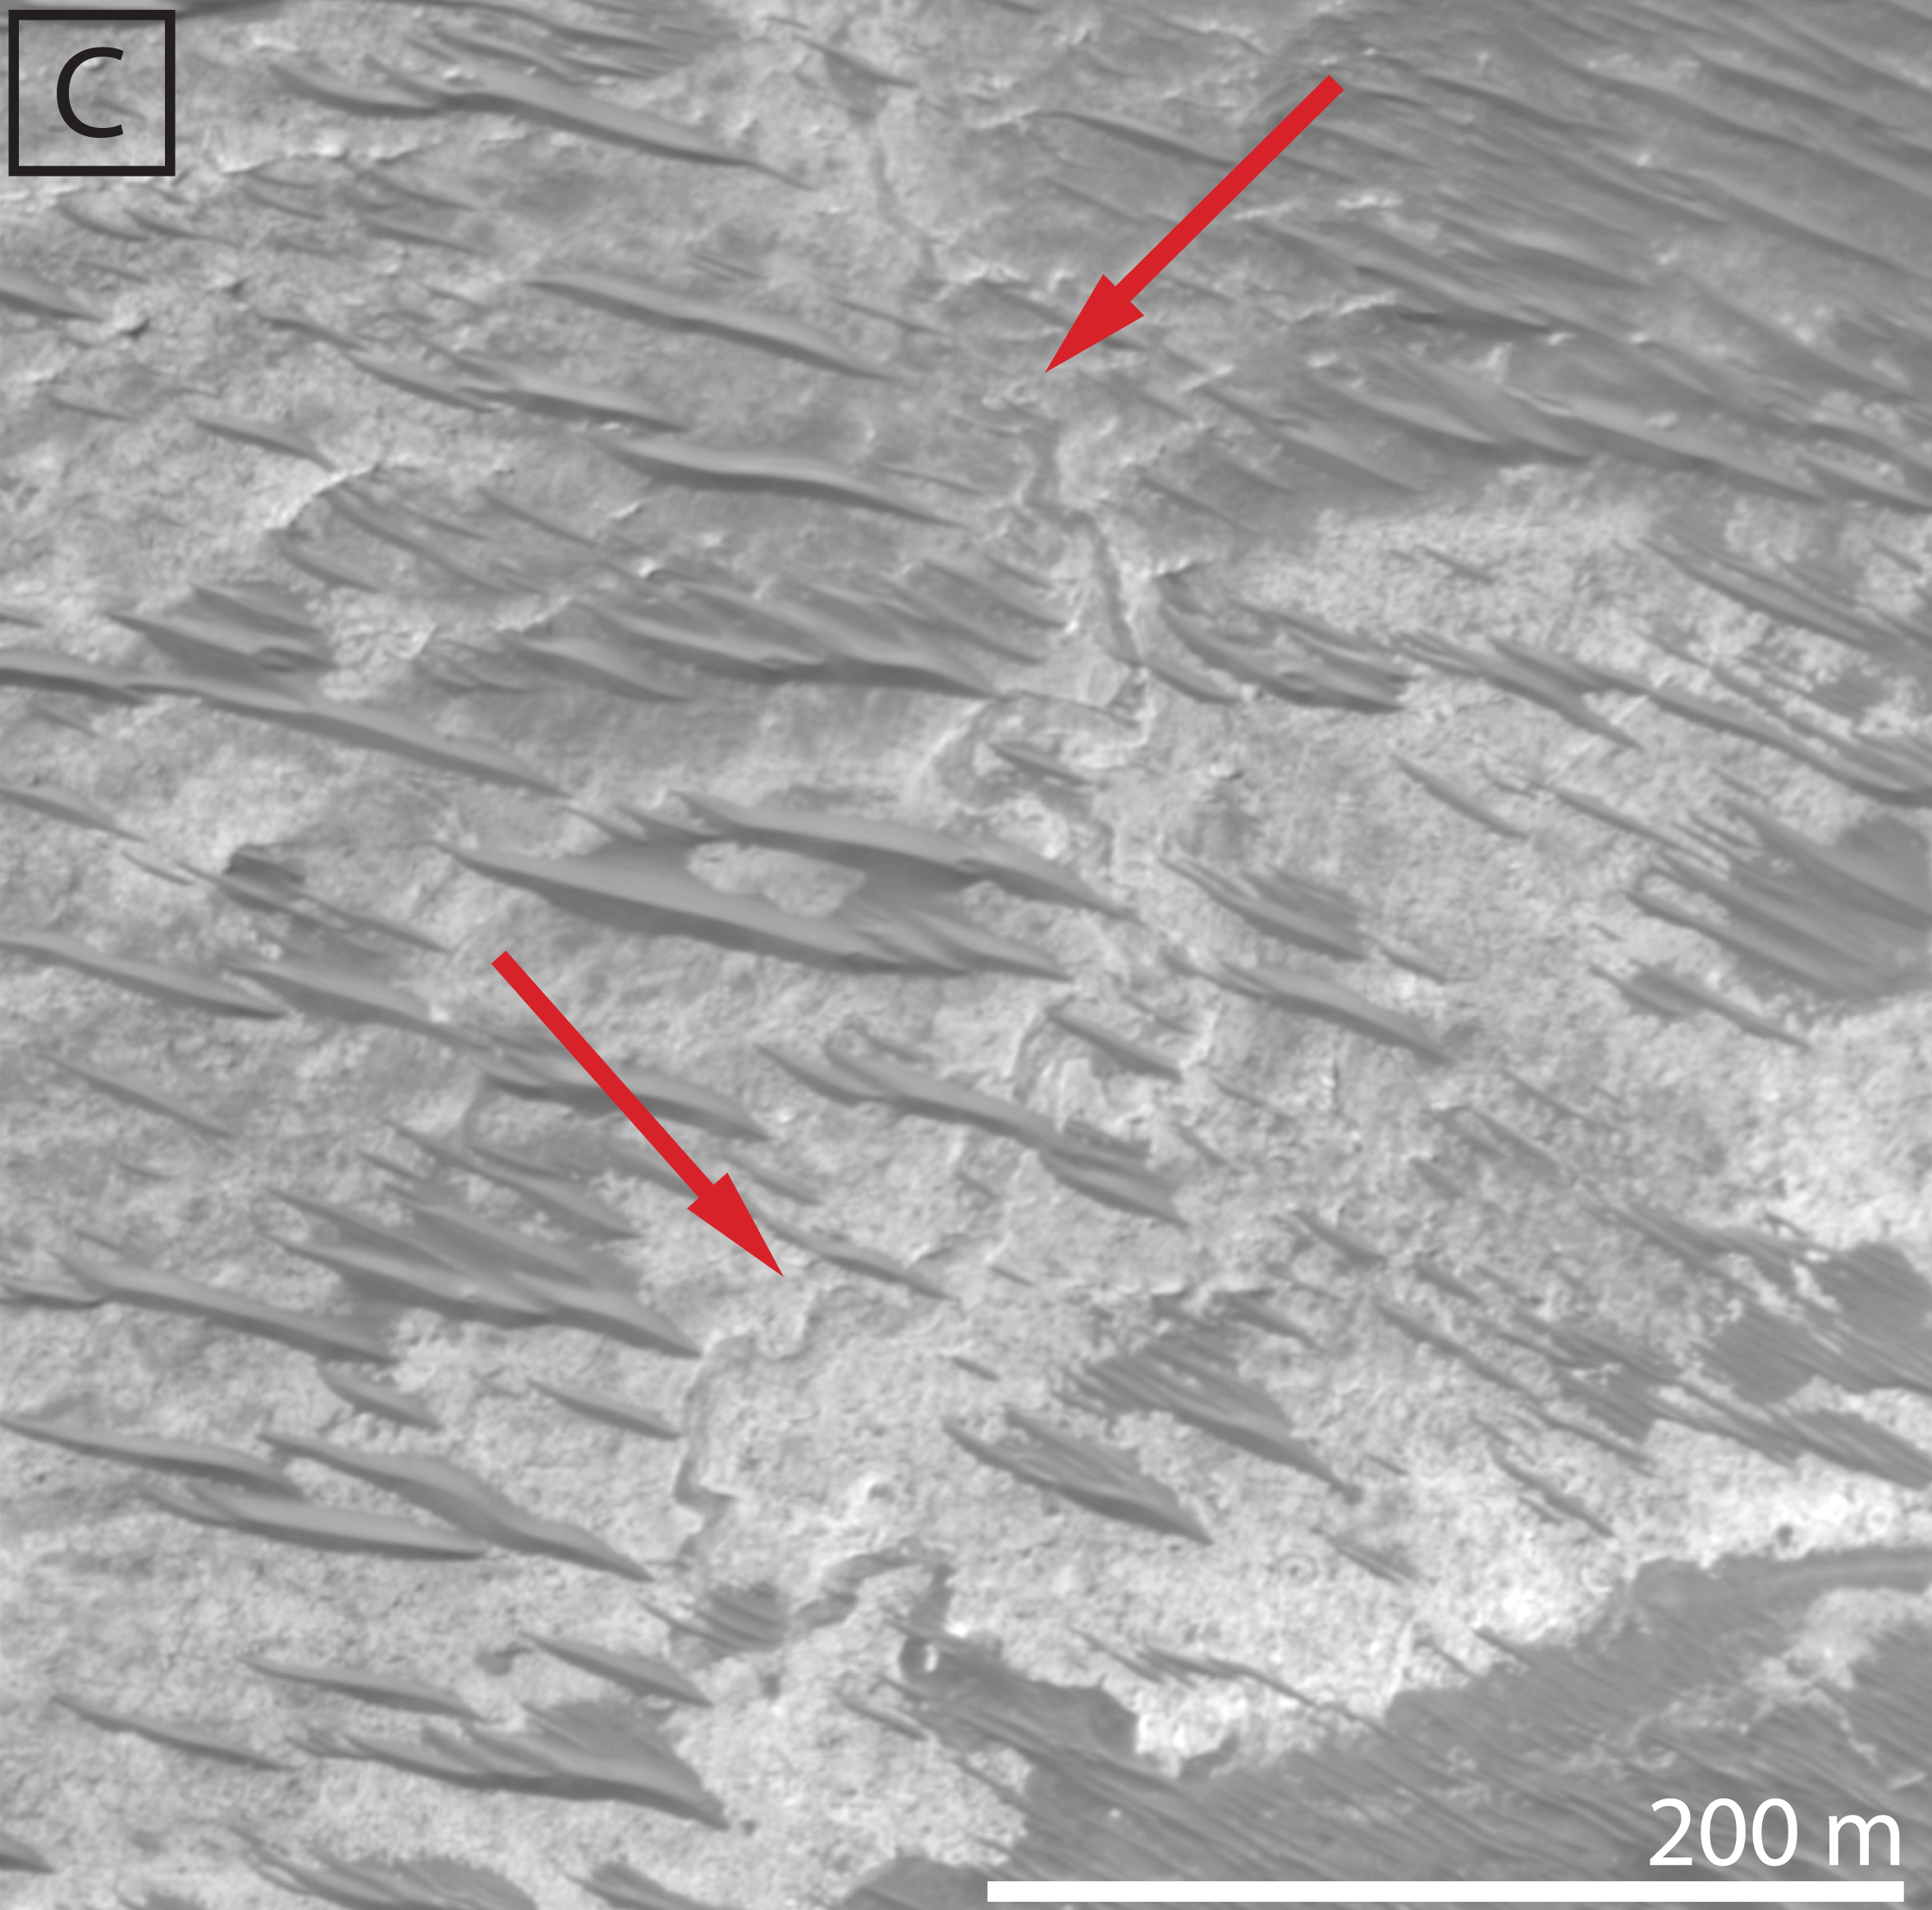
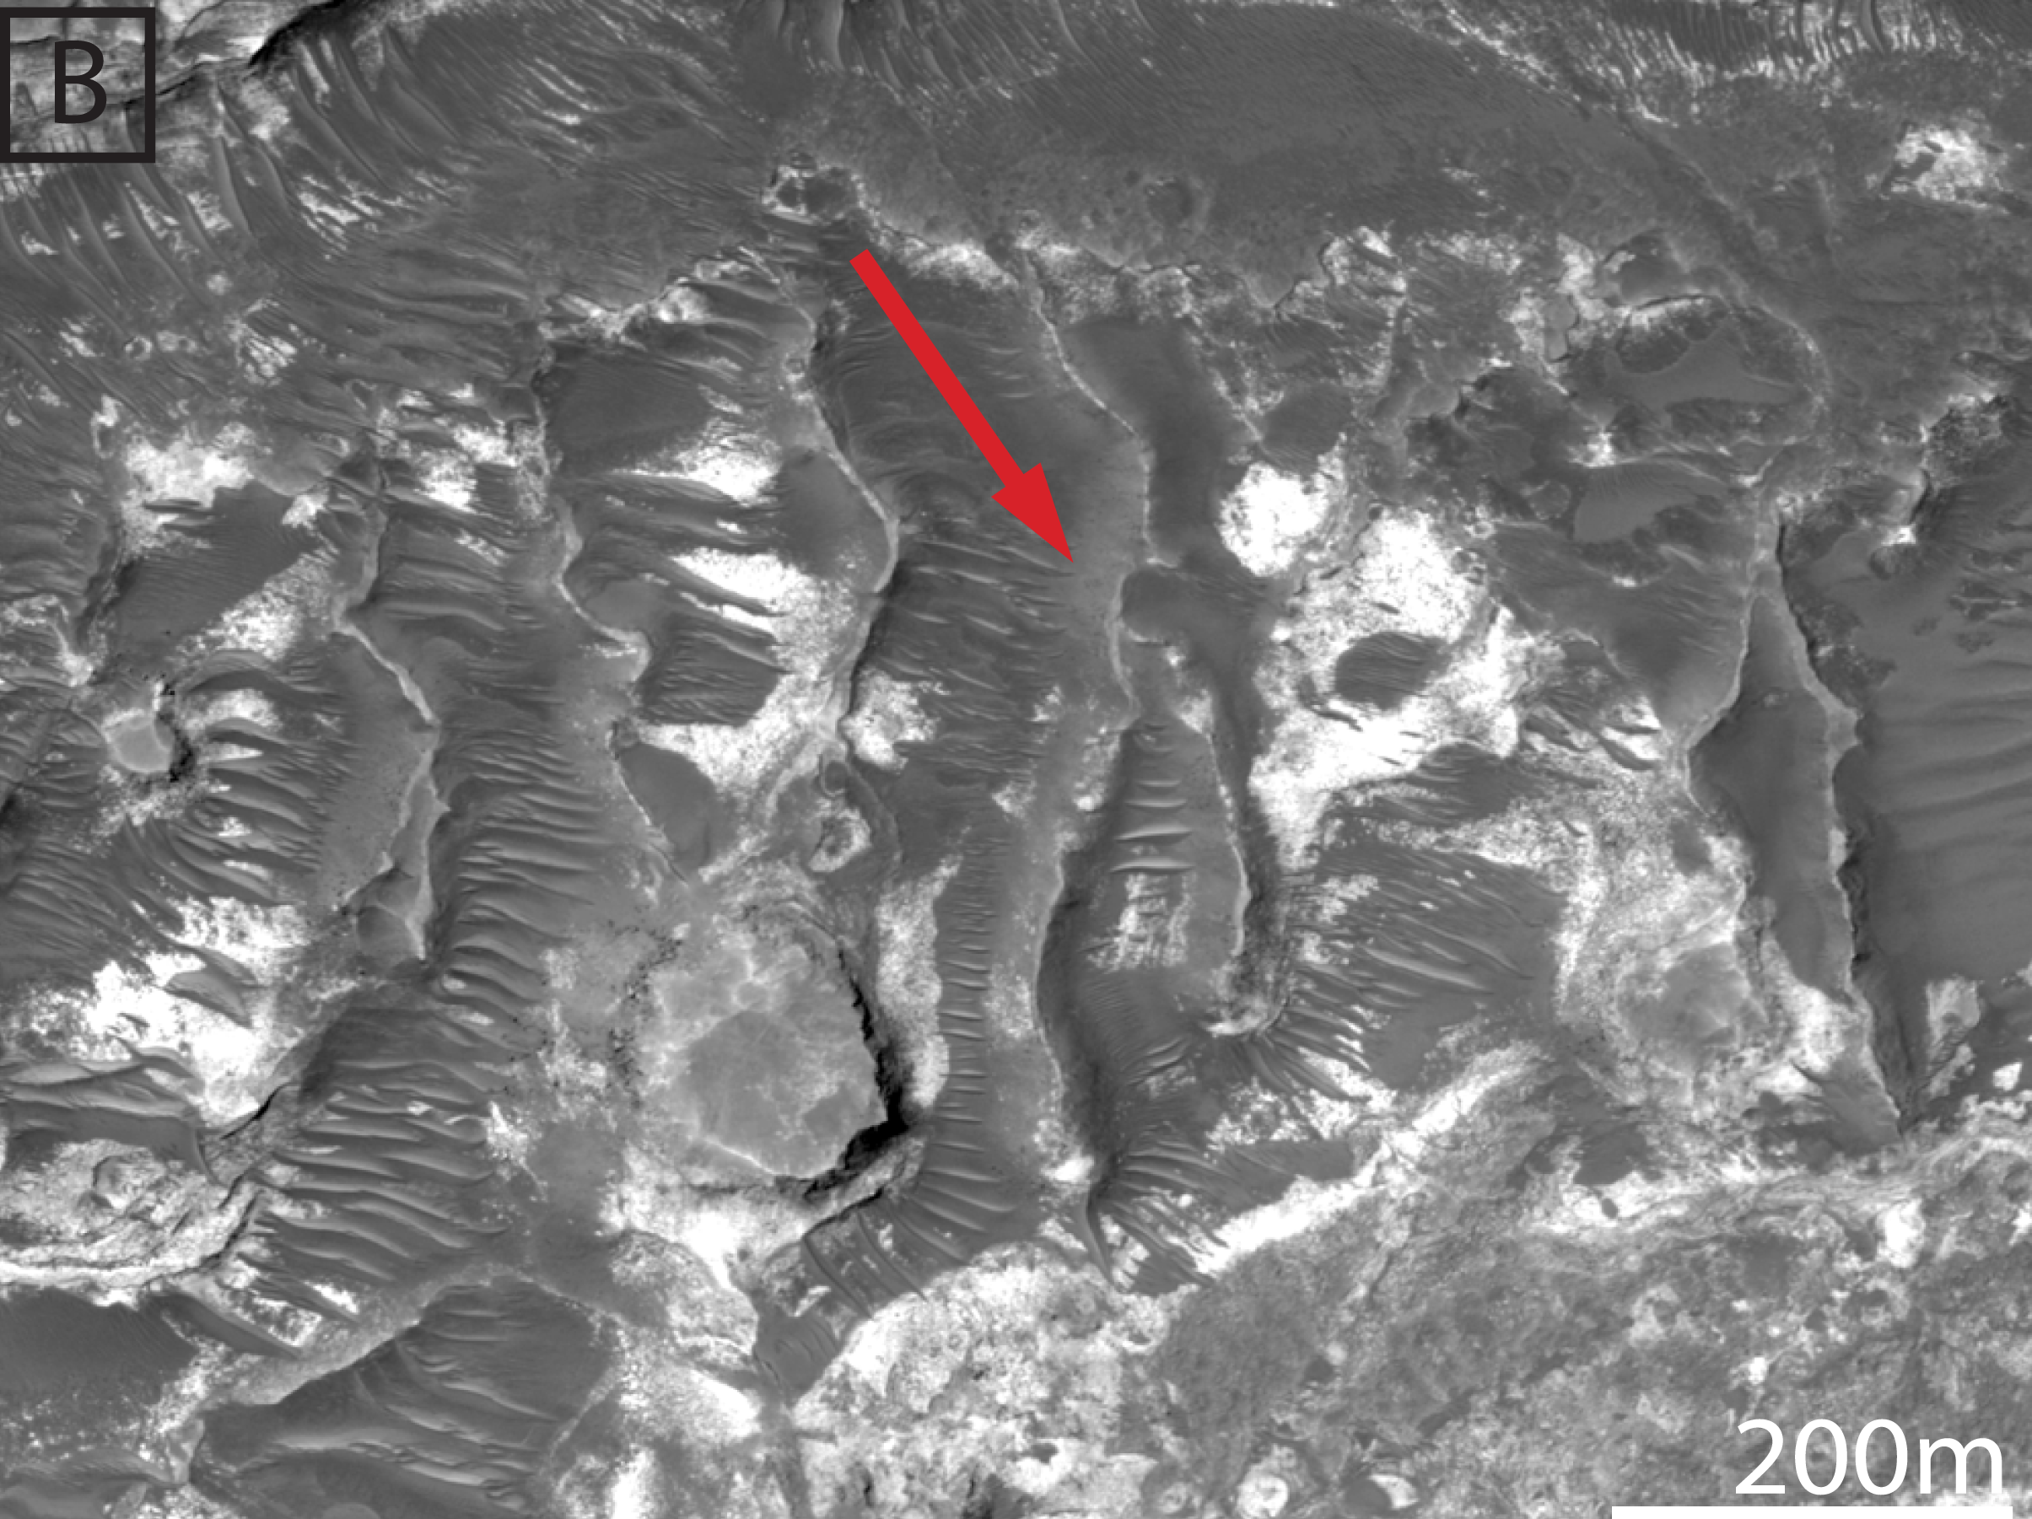
Channel-form Features

Slide 6
Distribution of Channel form features within Hadriacus Cavi

Slide 7
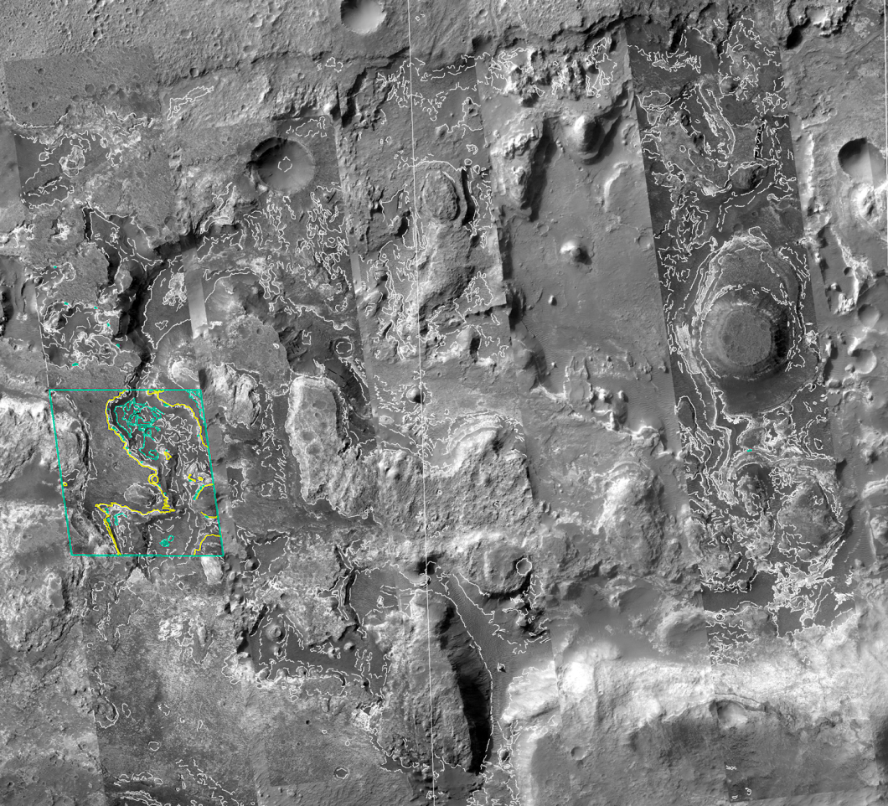
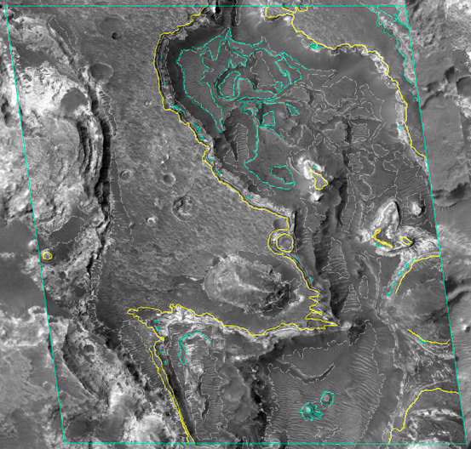
Geologic Map of Subset Area
2 km
1:24,000
10 km
1:125,000

Slide 8
Next Steps
Expanded mapping of Hadriacus Cavi
-Unit Correlation
  -Stratigraphic section
More in-depth interpretations of geologic history
Unit descriptions
USGS SIM (Scientific Investigations Map)
Contribute to map components

Slide 9
ACKNOWLEDGMENTS
Jim Skinner
USGS Astrogeology Department
Nadine Barlow
Kathleen Stigmon
Nasa Space Grant
QUESTIONS?

